Slide 1
Deviance zones
Lindsay Mayka
Associate Professor of Government
Colby College
LRMayka@colby.edu

Slide 2
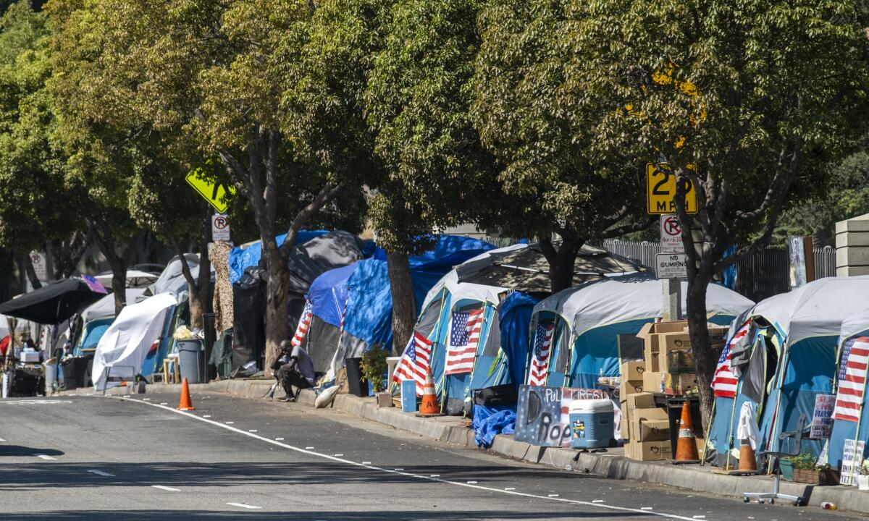
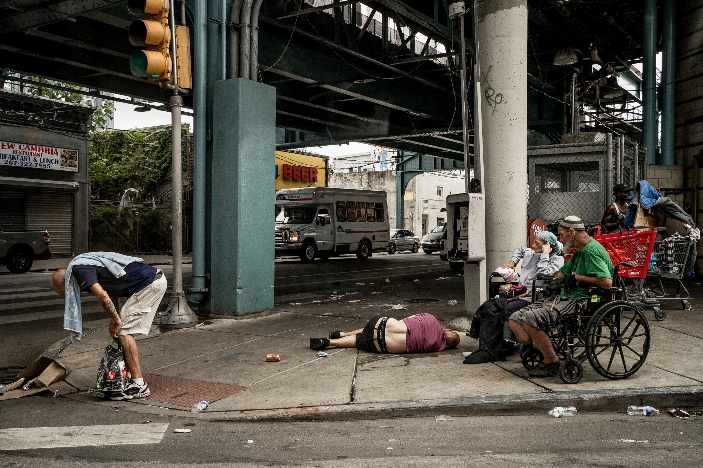
Politics of Deviance Zones
Deviance zones: territorial spaces that are sites of deviant behavior by highly stigmatized groups
Found in contexts of high social inequality – both Global South and Global North

Slide 3
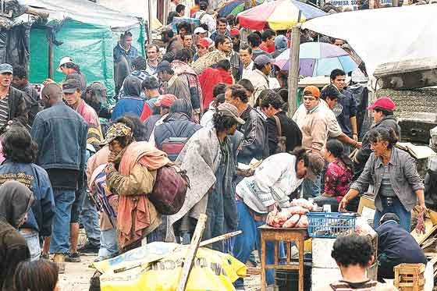
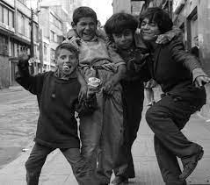
Who: Highly Stigmatized Groups
Populated by groups subject to high levels of stigma: those marginalized by the marginalized
Seen as morally deficient and threatening
Examples: people experiencing homelessness, drug users, sex workers, street kids, Roma, trans people
Contrasted with upstanding citizens

Slide 4
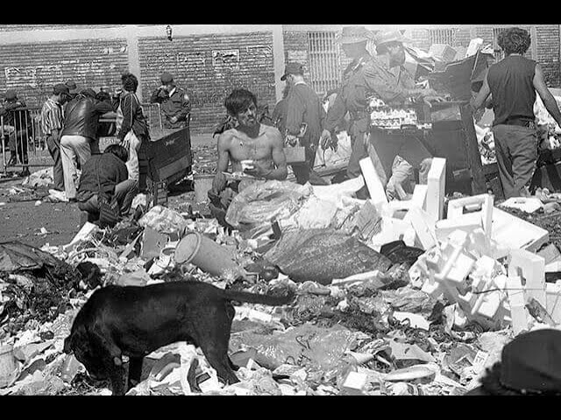
What: Deviant Behavior
Epicenter of illicit and/or disorderly behavior
Examples: violent crime, drug sales and consumption, prostitution, littering, public urination/defecation, recycling
Often involves criminal organizations
Presented as security and moral threat to upstanding citizens

Slide 5
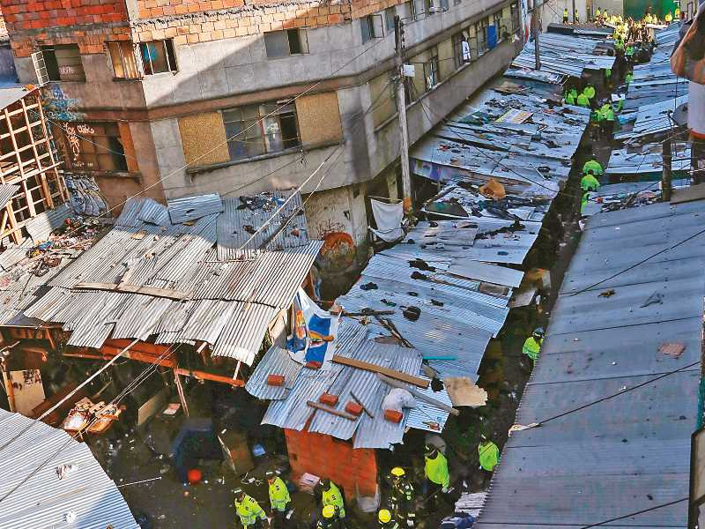
Where: Delimited Territorial Space
Stigmatized groups and deviant behavior is contained within a specific territory
Zone becomes synonymous with threat of deviance
Examples: El Bronx (Bogotá), Cracolândia (São Paulo), Tenderloin (SF), El Bordo (Tijuana), Roma camps in Bobigny (Paris)

Slide 6
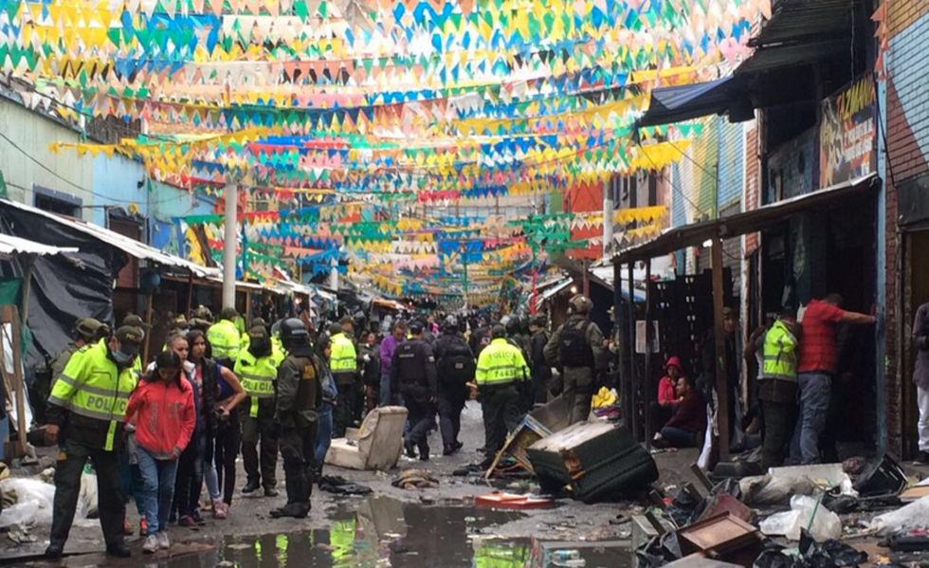
State Responses to Deviance Zones
How do states respond to deviance zones?
Four potential responses from state with distinct objectives
Strategies: carrots and sticks

Slide 7
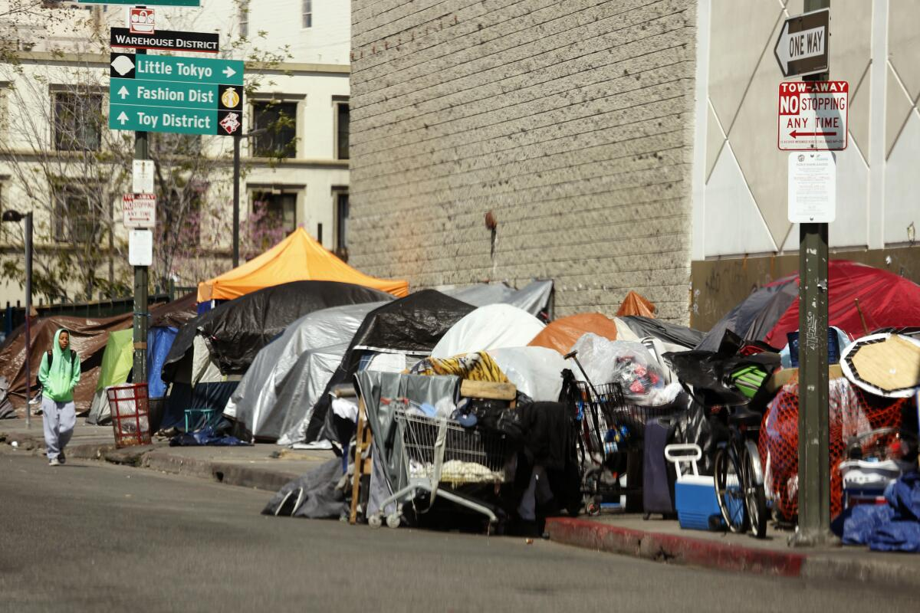
State Responses: Containment
Carrots: Concentrating social services in the deviance zone to prevent people from leaving
Sticks: Use of state violence to discourage people from leaving deviance zone

Slide 8
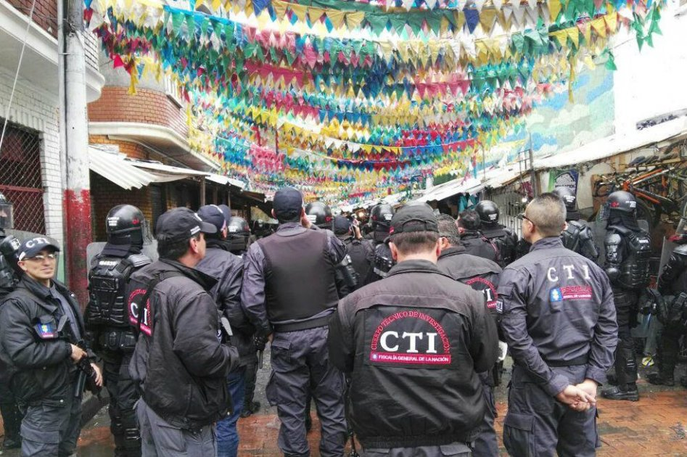
State Responses: Dispersion
Carrots: Move services away from deviance zone and/or providing benefits to encourage people to leave
Sticks: Police violence, harassment to prevent people from concentrating a deviance zone

Slide 9
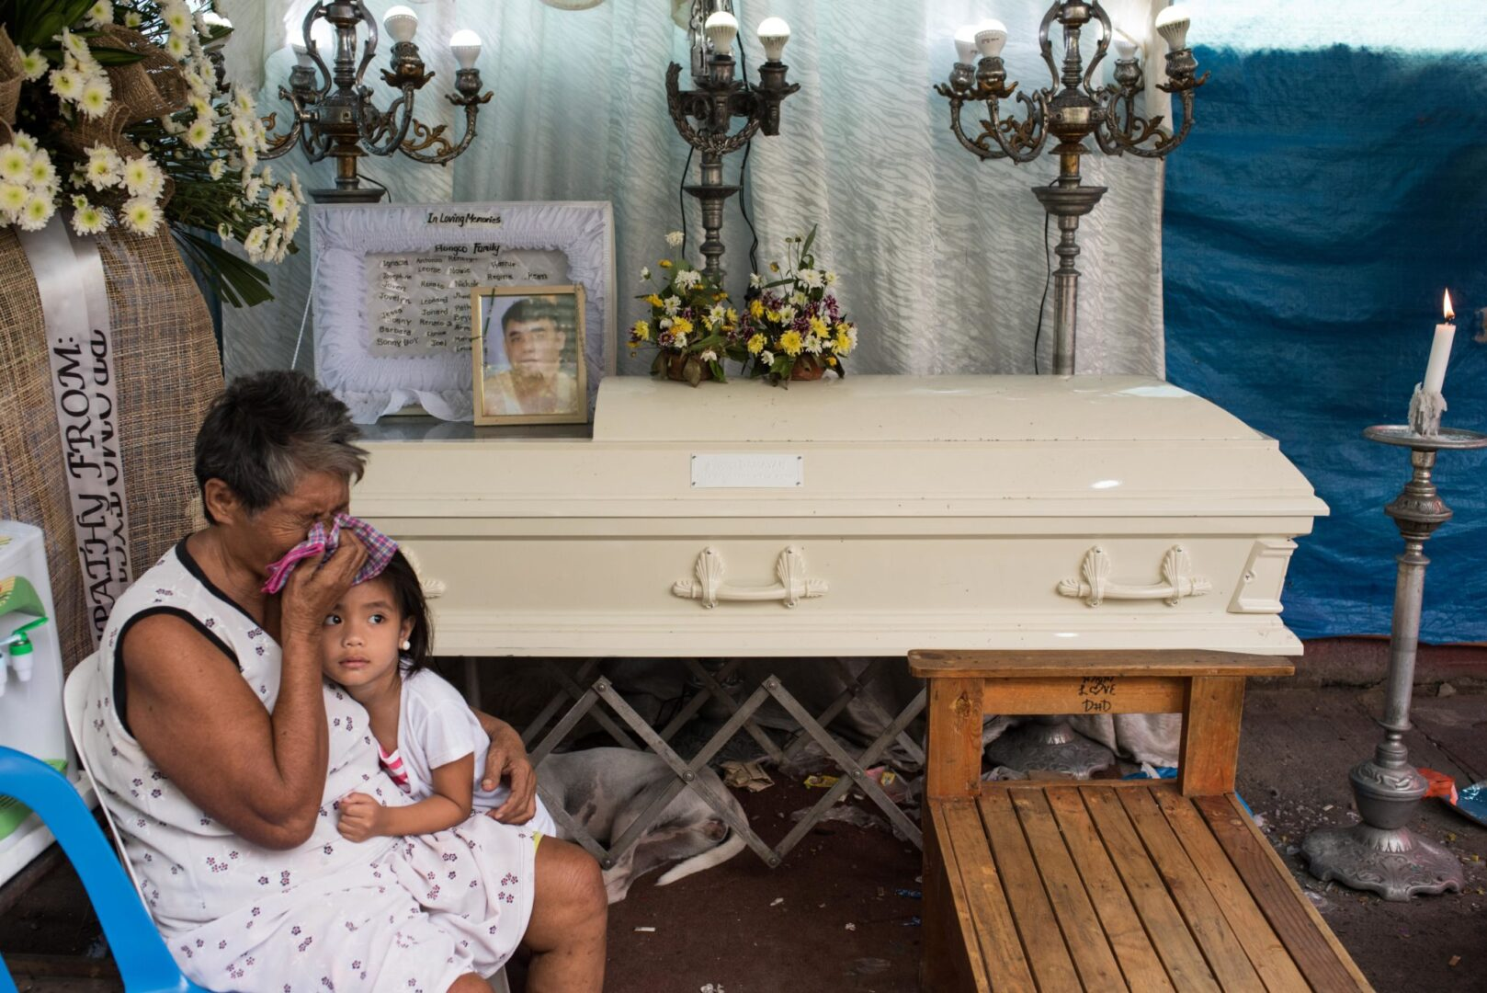
State Responses: Elimination
Carrots: N/A: primarily relies on force because denies citizenship of marginalized group
Sticks: State violence to eliminate disorder and/or stigmatized groups

Slide 10
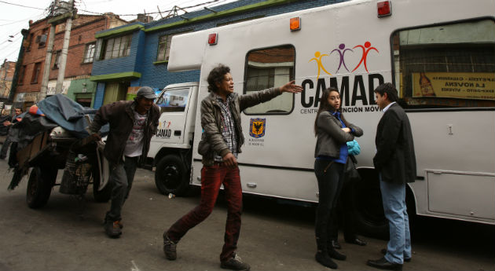
State Responses: Inclusion
Carrots: Effective social and economic policies to reduce the root causes of the social problem
Sticks: N/A: state violence undermines the goals of inclusion

Slide 11
Future Directions for Paper
Do I need to develop (and test?) hypotheses to explain why states pursue different responses?
If so, what empirical evidence would I need?
What other cases can I use to illustrate?
Mapping out a research agenda: what questions to raise for further research?

